Slide 1
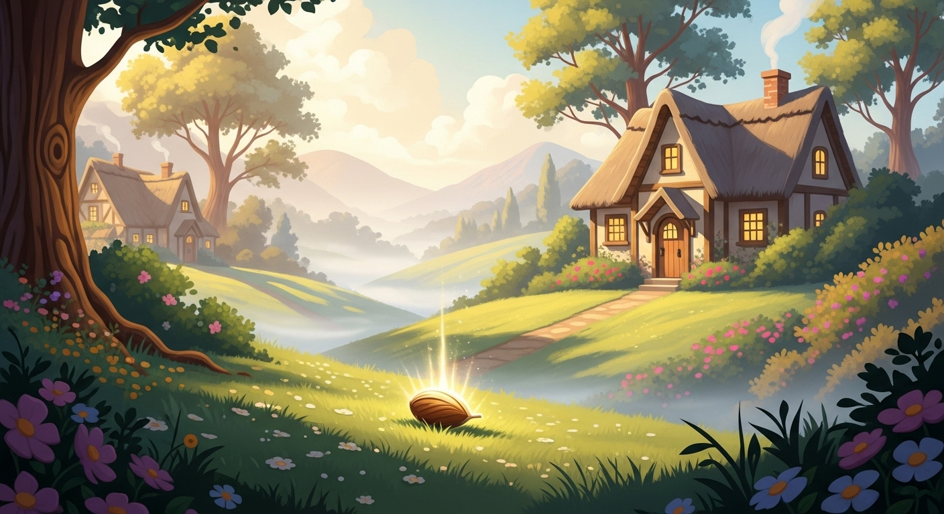
The Lost Seed

Slide 2
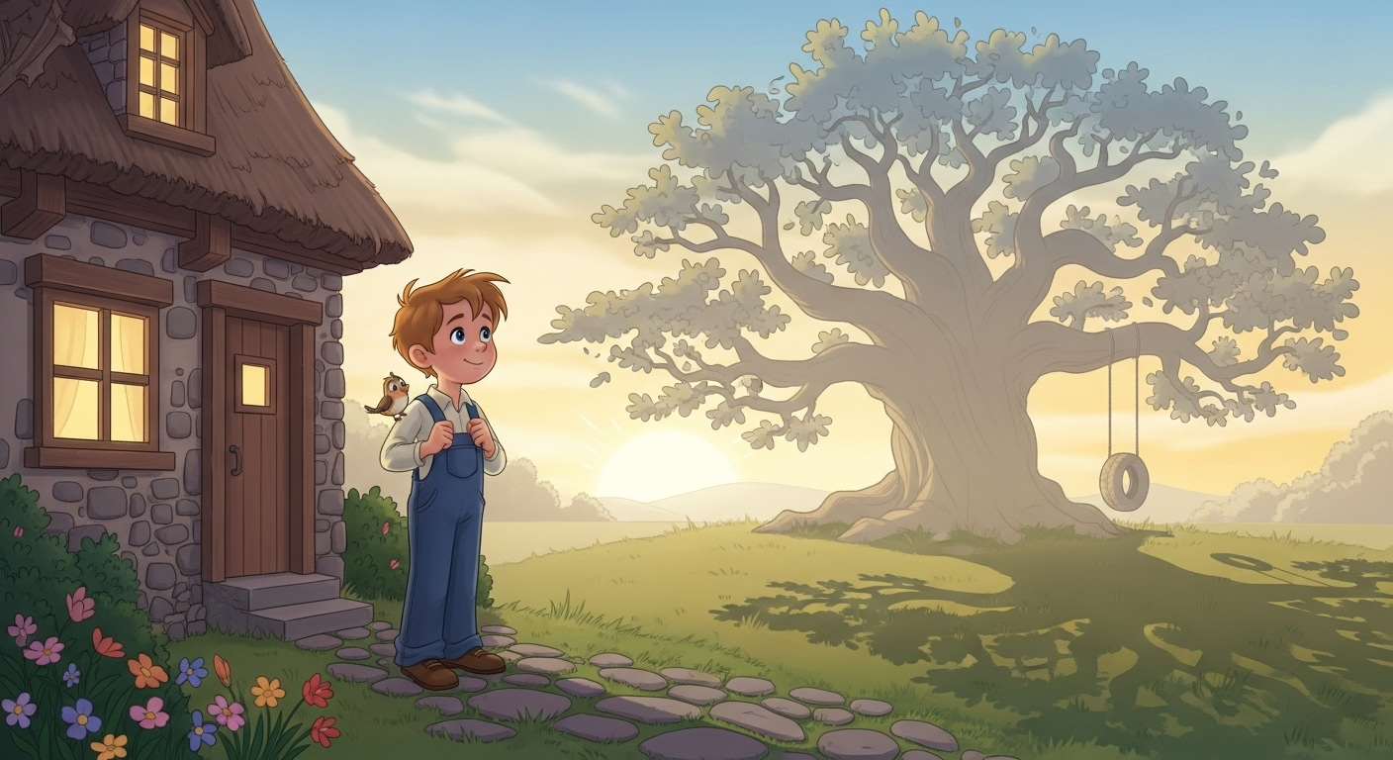
There lived a boy named Ali in a small village. He always wished to have a big tree in front of his house.

Slide 3
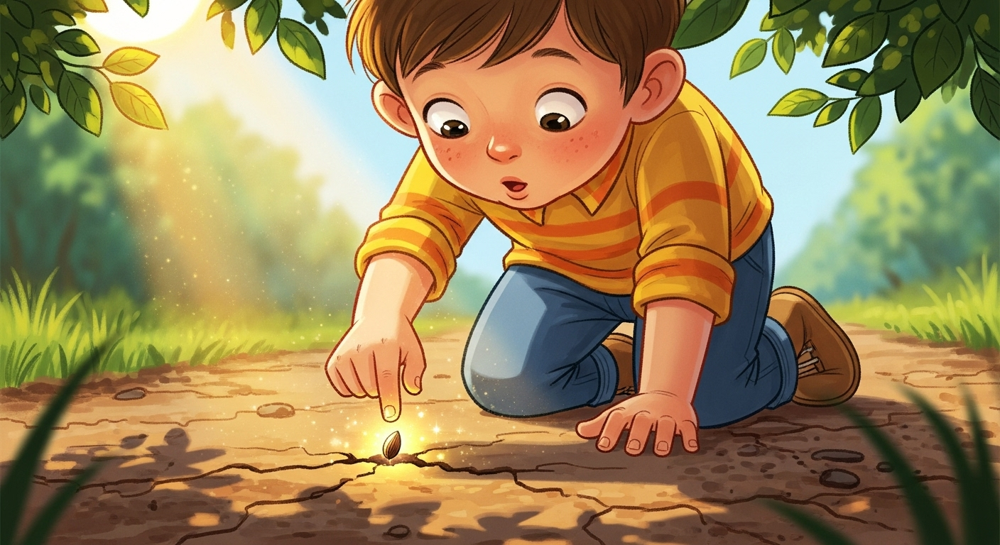
One day, he found a small seed on the road. He thought, “Maybe this seed can grow into a big tree!”

Slide 4
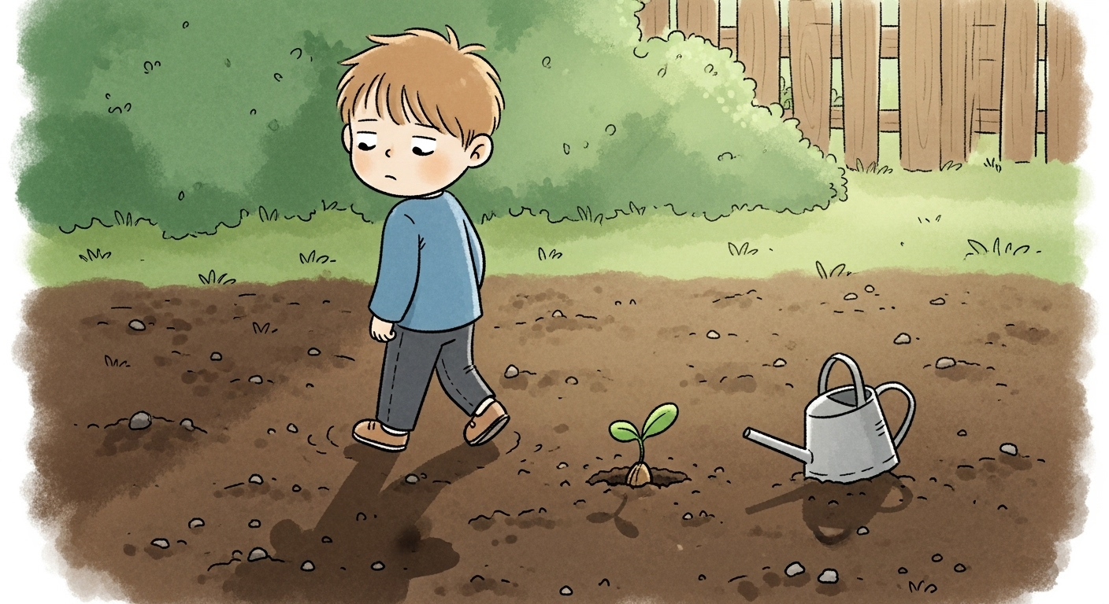
Ali planted the seed in the soil. But… he forgot to water it.

Slide 5
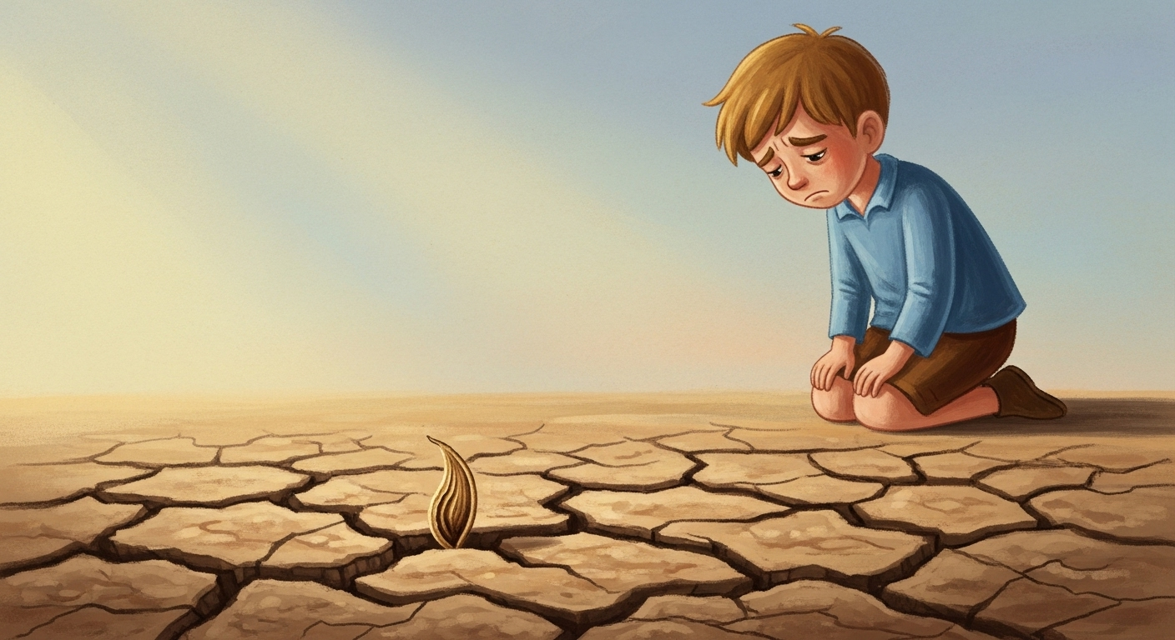
A few days later, he checked the seed —
it was dry and dead.

Slide 6
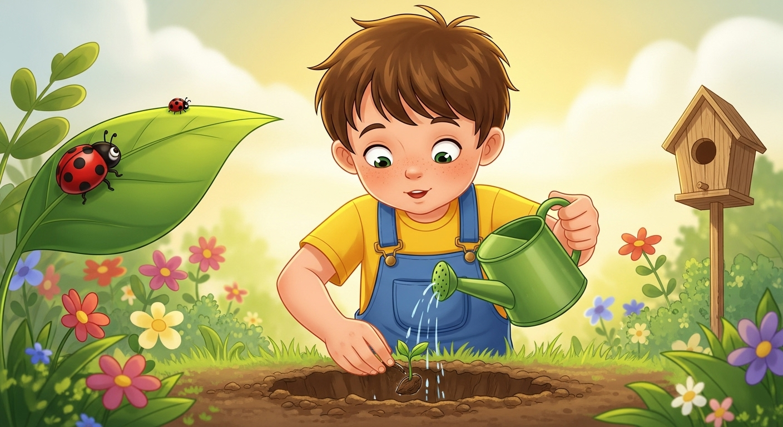
Ali didn’t give up. He planted another seed. This time, he watered it daily and took good care of it.

Slide 7
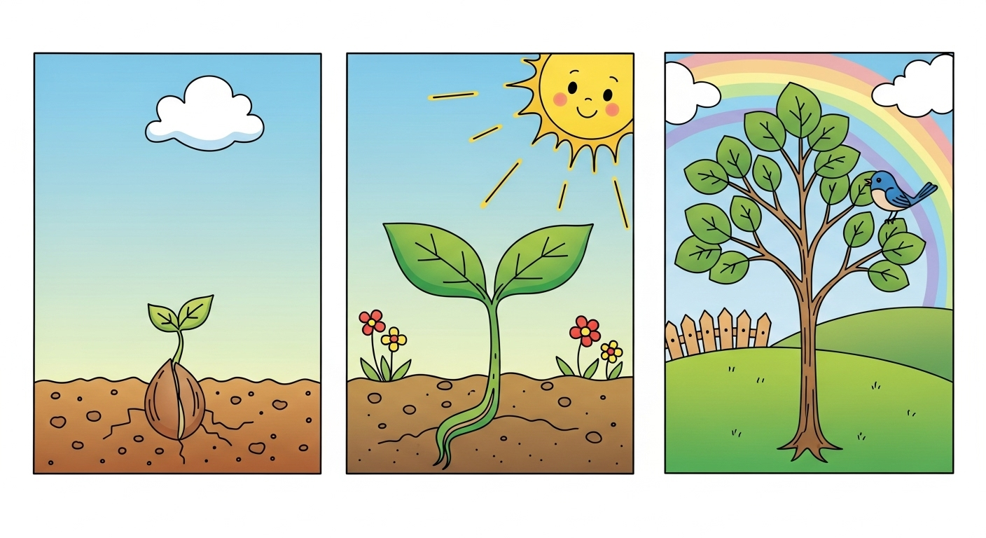
Slowly, the seed sprouted, then became a small plant, and after some months, a beautiful young tree

Slide 8
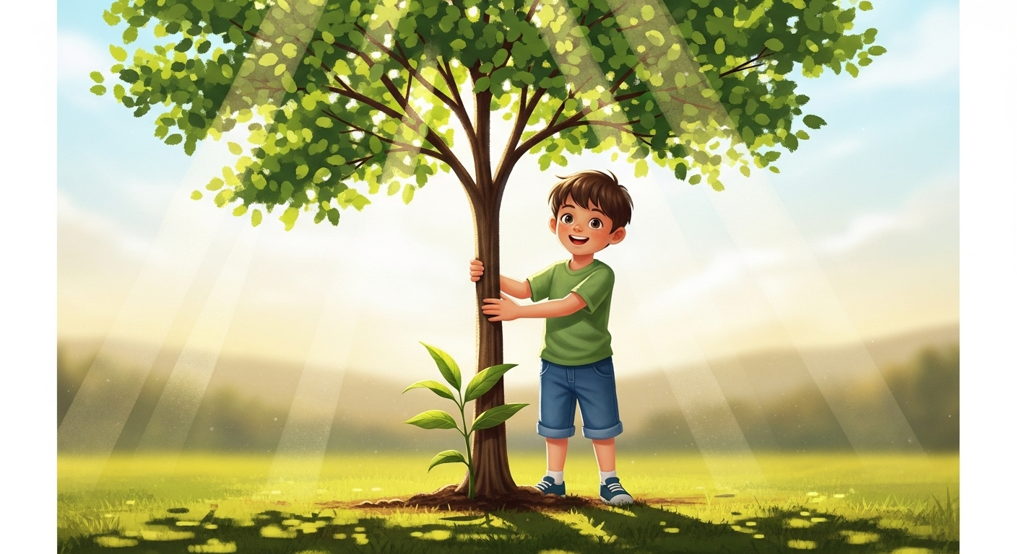
Ali learned: “Success is like a seed. If you take care of it every day, it grows into something great.”

Slide 9
